Slide 1


DEPARTMENT OF COMPUTER SCIENCE AND ENGINEERING
20CS8504 & PROJECT WORK
END SEMESTER PRACTICAL EXAMINATION- APRIL / MAY - 2026
Batch No.: 17
Date: 25/03/26
Session: AN

Slide 2
A Web Based Machine Learning System for Early Detection and Risk Prediction of Neonatal Sepsis in NICU
Guide Name:
Ms.P.Karthika
Assistant Professor
CSE
Team Members:
Shanmathi S (811722104141)
Uma Maheswari K (811722104170)
Vedha Varshini V (811722104178)

Slide 3
OBJECTIVE OF THE PROJECT
1. To develop a system for early prediction of neonatal sepsis before culture confirmation.
2. To reduce delays caused by the 3–4 days blood culture diagnostic process.
3. To support timely antibiotic decision-making in high-risk newborns such as VLBW and premature infants.
4. To help decrease sepsis-related neonatal mortality, especially in high-burden countries like India.
5. To improve neonatal outcomes by assisting clinicians in early recognition and intervention.

Slide 4
INTRODUCTION
1. Neonatal sepsis causes 1.3 million cases globally every year, leading to more than 200,000 deaths, making it a critical public health concern in NICUs.
2. Blood culture confirmation requires 3–4 days, forcing clinicians to start empirical antibiotics without confirmed diagnosis in routine hospital practice.
3. Since the results take long time, the web-based model helps clinicians make quicker treatment decisions based on clinical data.
4. This project introduces a model that assists clinicians in early risk assessment during examination, enabling faster intervention and rational antibiotic use in daily NICU operations.
5. The web platform integrates smoothly into daily hospital workflow, making advanced machine learning accessible without requiring technical expertise.

Slide 5
LITERATURE SURVEY
TITLE OF PAPER | AUTHOR(S) | PAPER GIST | TECHNOLOGY USED
Predicting Sepsis Onset in ICU Using Machine Learning Models: A Systematic Review and Meta-Analysis | Zhenyu Yang, Xiaoju Cui, Zhe Song | Reviews multiple machine learning models that analyze ICU patient data such as vital signs and laboratory results to predict sepsis early. | Random Forest, XGBoost, Support Vector Machine, Neural Networks
Machine Learning and Deep Learning Models for Early Sepsis Prediction: A Scoping Review | Hemalatha Shanmugam, Lavanya Airen, Saumya Rawat | Explores deep learning and machine learning models that use electronic health records and clinical data for early sepsis prediction. | Logistic Regression, CNN, RNN, LSTM
Optimizing Sepsis Treatment Strategies via a Reinforcement Learning Model | Tianyi Zhang, Yimeng Qu, Deyong Wang, Ming Zhong | Develops a reinforcement learning approach to optimize medication strategies and treatment decisions for sepsis patients. | Deep Reinforcement Learning (Dueling DDQN model)
Vital Sign-Based Detection of Sepsis in Neonates Using Machine Learning | Axel Honoré, Erik Persad, David Forsberg, Håkan Olsson | Uses machine learning techniques to analyze neonatal vital-sign data for early detection of sepsis. | Machine Learning – Naïve Bayes classifier
Applying Machine Learning to Blood Count Data for Prediction of Sepsis | Jonas W, Markus H, Daniel S, Michael B | Uses complete blood count (CBC) laboratory data with machine learning models to predict sepsis risk. | Boosted Random Forest machine learning model

Slide 6
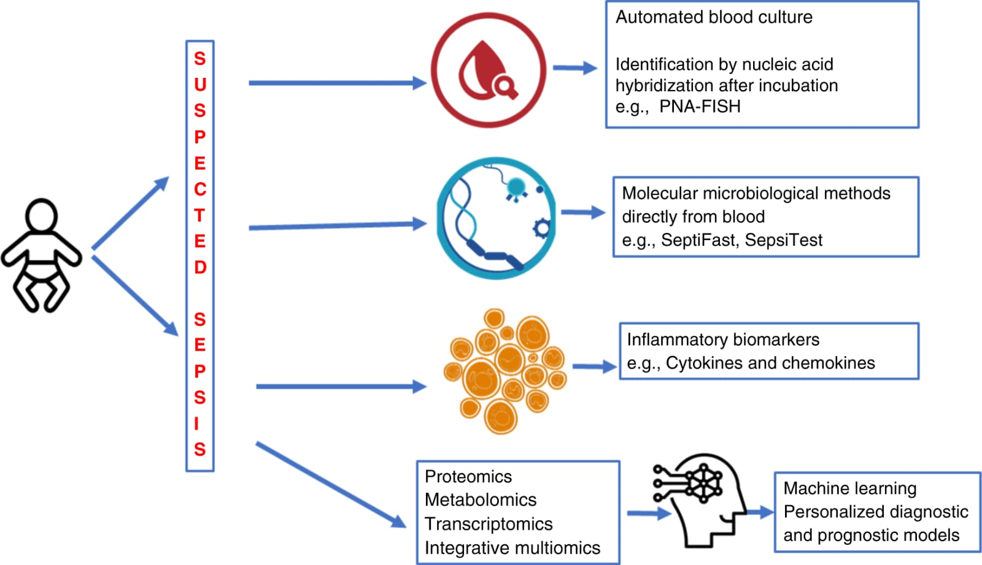
EXISTING SYSTEM ARCHITECTURE

Slide 7
PROBLEM IDENTIFIED
1. Early symptoms of infant sepsis are subtle and often detected only after the condition becomes critical.
2. Traditional hospital monitoring relies on manual observation of vital signs, which can lead to delayed diagnosis.
3. Continuous monitoring of multiple patients in NICU is difficult for healthcare staff, increasing the risk of missed warning signs.
4. Many existing sepsis prediction models act as black-box systems without clear clinical interpretability.
5. Most current systems focus only on prediction accuracy and lack automated real-time alert mechanisms for caregivers.

Slide 8
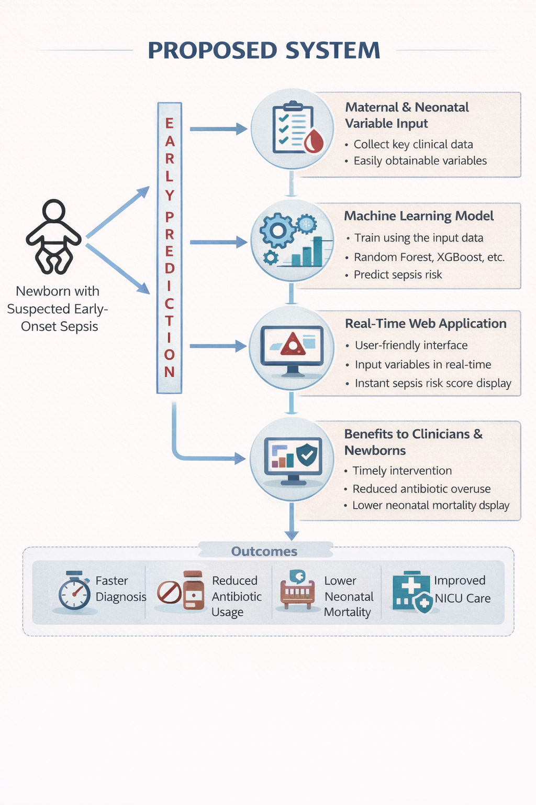
PROPOSED SYSTEM ARCHITECTURE

Slide 9
SOFTWARE AND HARDWARE REQUIREMENTS
HARDWARE
1. Processor: Intel Core i5 / AMD Ryzen 5 or higher (for ML model training).
2. RAM: 8 GB (16 GB recommended for faster model training).
3. Storage: At least 256 GB.
4. System Type: 64-bit system (required for ML libraries).
SOFTWARE
1. Operating System: Windows 10 / Linux / macOS (64-bit).
2. Programming Language: Python 3.8+
3. ML Libraries: Scikit-learn (Random Forest, SVM) XGBoostPandas, NumPy (data handling).
4. Development Tools: Jupyter Notebook.
5. Web Framework: Flask / Django (Python).

Slide 10
MODULES
1. User Information Acquisition Module
2. Patient Vital Parameters Input Module
3. Sepsis Risk Prediction Module
4. Automated Alert and Email Notification Module
5. Prediction Result Visualization Module

Slide 11
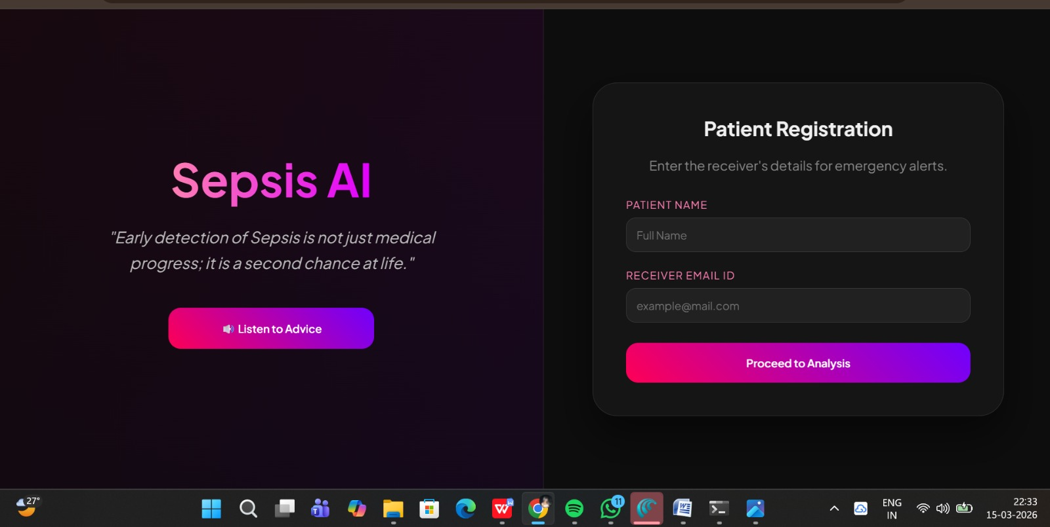
MODULE-1
User Information Acquisition Module
1. This module collects the basic details of the user such as name and email address through the system interface.
2. The entered information is stored temporarily in the system for identification and communication purposes.
3. The email ID is used as the primary channel for sending automated notifications and alerts.
4. The module ensures that valid user information is captured before proceeding to the next stage of the system.
5. This step establishes the connection between the caregiver and the monitoring system for future alerts.

Slide 12
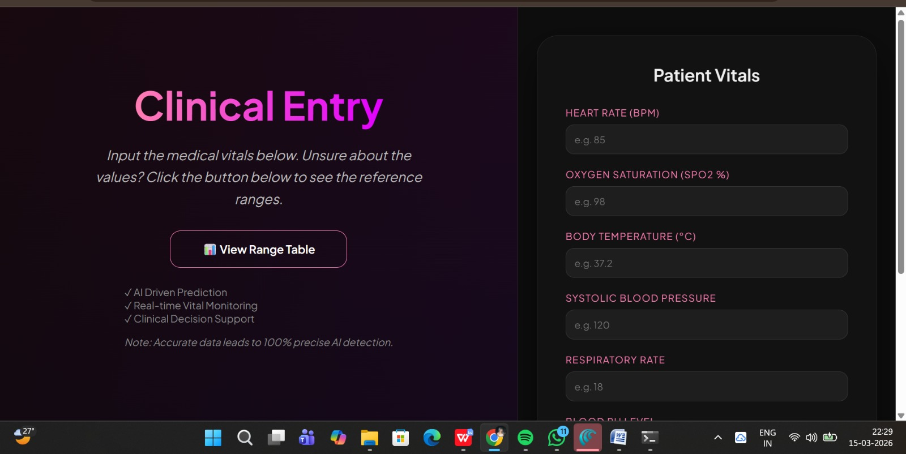
MODULE-2
Patient Vital Parameters Input Module
1. This module collects essential patient physiological parameters such as heart rate, body temperature, respiratory rate, and oxygen saturation.
2. The user enters these vital values through a web-based input interface.
3. The system validates the input values to ensure they fall within medically acceptable ranges.
4. Data preprocessing operations such as formatting and cleaning are performed to prepare the data for analysis.
5. The processed data is then forwarded to the machine learning prediction module.

Slide 13
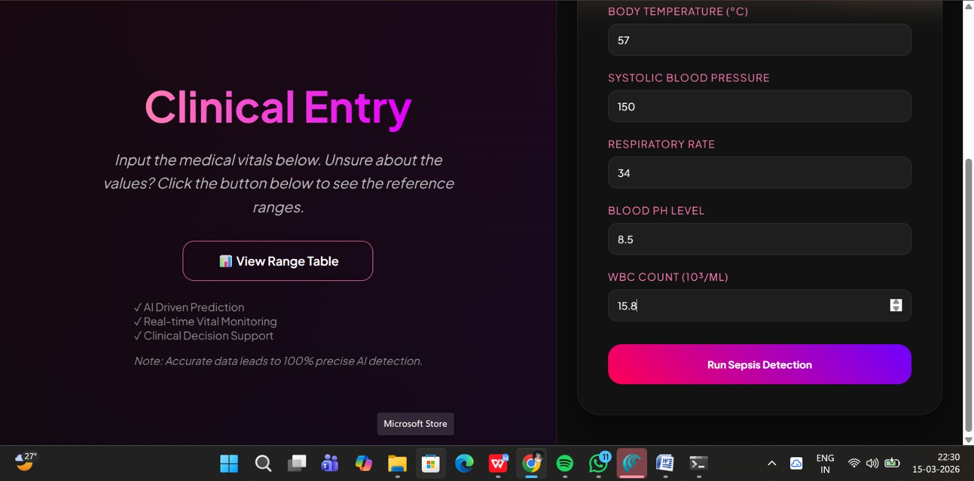
MODULE-3
Sepsis Risk Prediction Module
1. This module uses a trained Random Forest machine learning model to analyze the processed patient vitals.
2. The algorithm compares the input parameters with patterns learned from historical medical datasets.
3. Multiple decision trees within the Random Forest classifier evaluate the probability of sepsis risk.
4. Based on the analysis, the model classifies the patient condition as either normal or at risk of sepsis.
5. The generated prediction result is then passed to the alert and visualization modules.

Slide 14
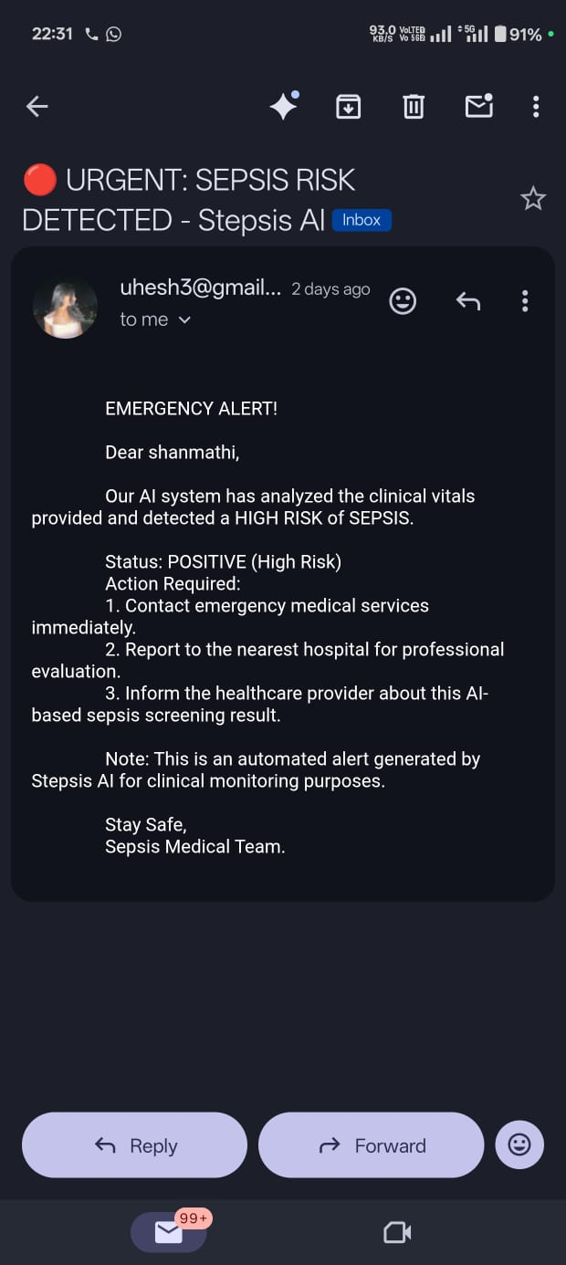
MODULE-4
Automated Alert and Email Notification Module
1. This module activates when the prediction model detects a potential risk of sepsis.
2. It automatically generates a warning alert to indicate a possible medical emergency.
3. The system sends a caution email notification to the registered guardian or caregiver.
4. The alert message informs the caregiver about the potential risk and recommends immediate medical attention.
5. This module ensures timely communication and faster response to critical health conditions.

Slide 15
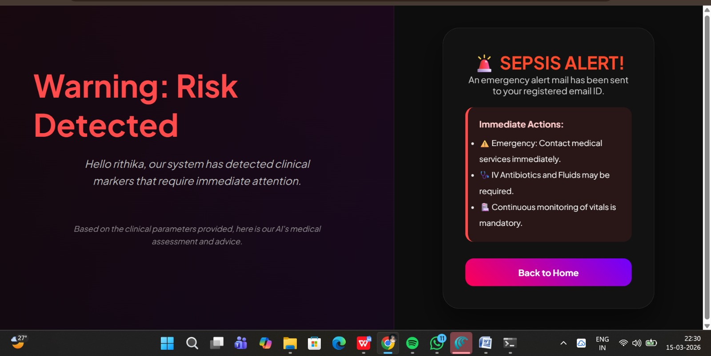
MODULE-5
Prediction Result Visualization Module
1. This module displays the prediction results clearly on the system interface.
2. The output indicates whether the patient is in a normal condition or at risk of sepsis.
3. The results are presented in an easy-to-understand format for caregivers and healthcare professionals.
4. The interface allows users to quickly review the entered patient parameters and prediction outcome.
5. This module helps users make informed decisions regarding further medical evaluation or treatment.

Slide 16
CONCLUSION
1. This project provides a real-time web-based decision support system that helps clinicians instantly assess neonatal sepsis risk at the bedside.
2. The website allows quick input of clinical parameters and generates immediate predictions, reducing delays in critical decision-making.
3. By delivering timely risk alerts, the system supports early initiation or withholding of antibiotics, improving treatment accuracy.
4. The web-based platform ensures easy accessibility across NICU systems without the need for complex software installations.
5. Overall, the project enhances quality of neonatal care by enabling faster responses, better resource utilization, and improved patient outcomes.

Slide 17
FUTURE ENHANCEMENTS
1. Integrate real-time data streaming from NICU monitoring devices and IoT sensors for continuous infant health monitoring.
2. Expand the system to support multi-hospital datasets to improve model accuracy and generalization.
3. Develop a mobile application for doctors and caregivers to receive alerts and monitor patient status remotely.
4. Incorporate advanced deep learning models and medical imaging analysis to enhance prediction performance.
5. Conduct real-world clinical validation with neonatologists to ensure reliability and practical deployment in hospitals.

